Slide 1

Bonifacio Global City (BGC) Bus Passenger Information System: Bus Tap
Group 5
ALCARAZ, ANNA LYNN C.
ANGOT, SAMMY BOY M.
BESMANO, JUSTIN V.
BRIOSO, JOB G.

Slide 2
Introduction

Slide 3
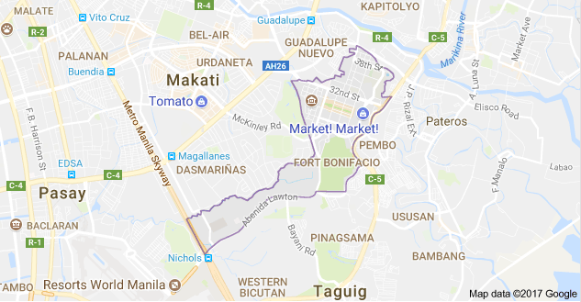
Bonifacio Global City (BGC)

Slide 4
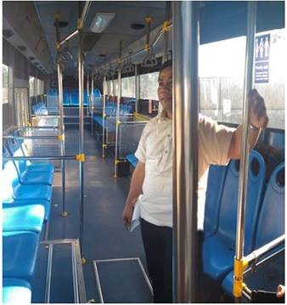
Interview: BGC Bus

Slide 5
BGC Bus
North Express
North Route
East Express
Central Route
Upper West Express
Lower West Express
Night Route
West Route
East Route
Ayala Express
Arca South Express
Nuvali Express

Slide 6
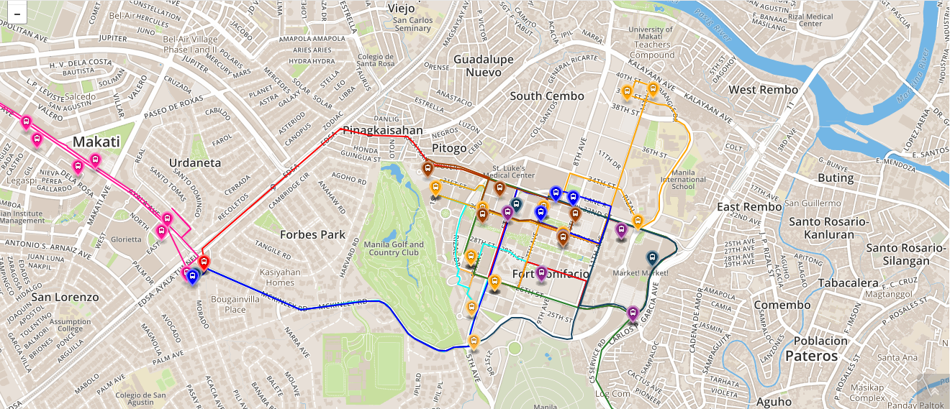
Bus Routes

Slide 7
Operating Schedule
Routes | Day | Time
North Express | Mondays to Fridays only | 6:00AM to 10:00PM
North | Mondays to Fridays only | 6:30AM to 10:00AM and 4:30PM to 8:30 PM
East Express | Mondays to Fridays only | 6:00AM to 10:00PM
Central | Everyday | 6:00AM to 10:00AM
Upper West Express | Mondays to Fridays only | 6:00AM to 10:00PM
Lower West Express | Mondays to Fridays only | 6:00AM to 10:00PM
Night | Everyday | 10:00PM to 6:00 AM
East | Weekends | 6:00AM to 10:00PM
West | Weekends | 6:00AM to 10:00PM
Ayala Express | Mondays to Fridays only | 7:00AM to 10:00AM
Arca South Express | Mondays to Fridays only | 6:10AM to 9:00AM and 4:00PM to 8:00 PM
Nuvali Express | Mondays to Fridays only | 6:30AM, 6:30PM, and 7:15PM

Slide 8


Bus Fare
Php 12.00 for all routes, except Arca South and Nuvali
Tickets are not sold on board a BGC Bus.
Buy tickets at a cashier counter at selected stops and terminals.
Pay using their tap-and-go beep cards.

Slide 9
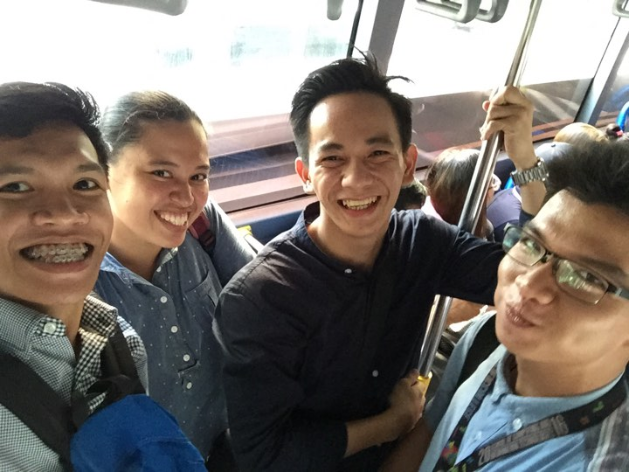
Survey: BGC Bus Passengers

Slide 10
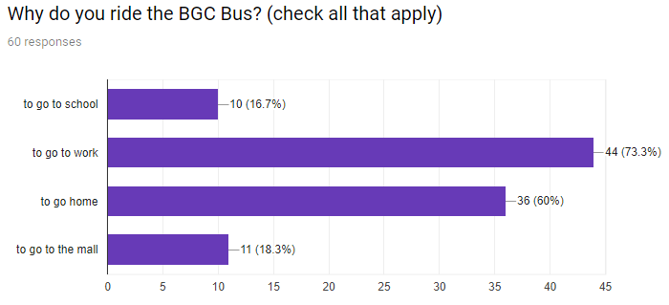
Results from survey conducted by the group
on the passengers of the BGC Bus

Slide 11
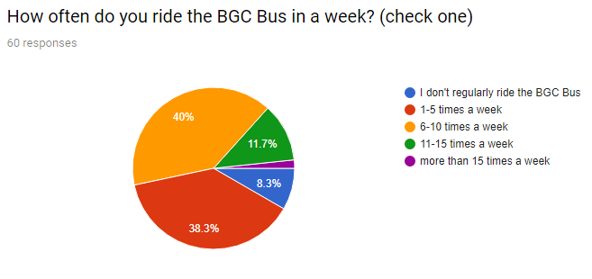
Results from survey conducted by the group
on the passengers of the BGC Bus

Slide 12
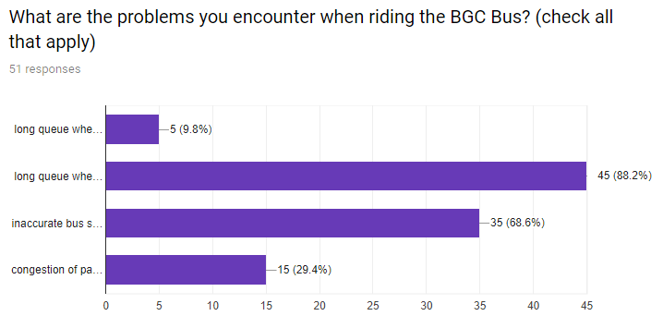
Results from survey conducted by the group
on the passengers of the BGC Bus

Slide 13
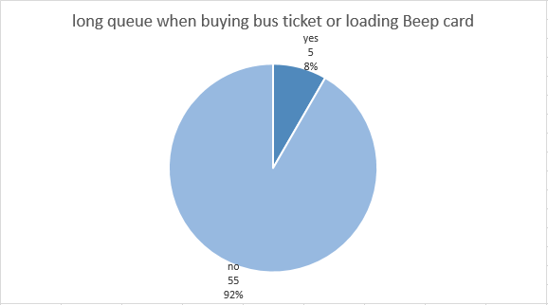
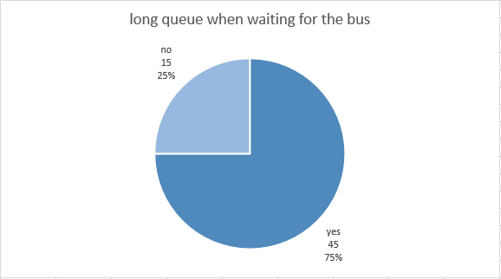
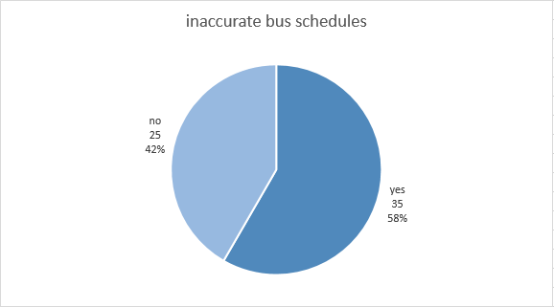
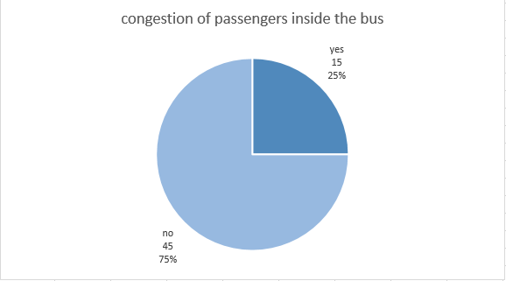

Slide 14
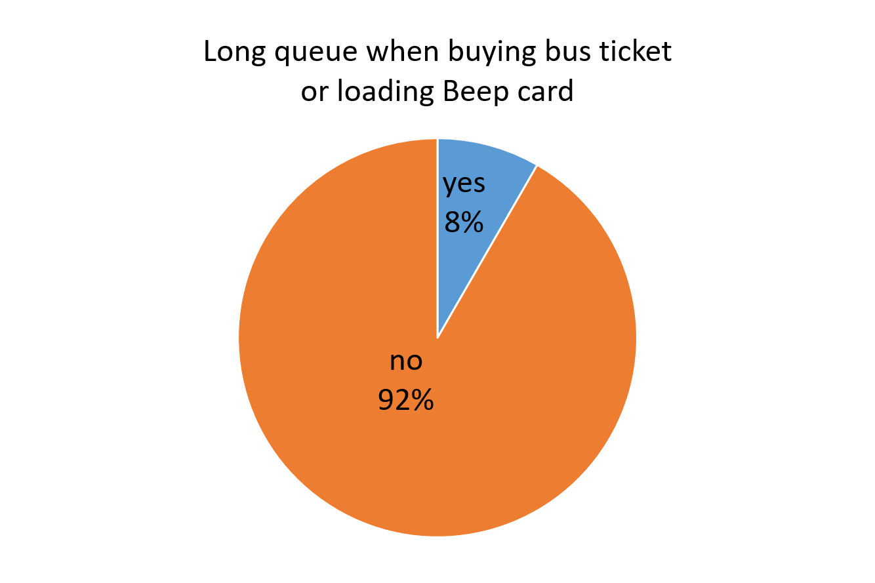
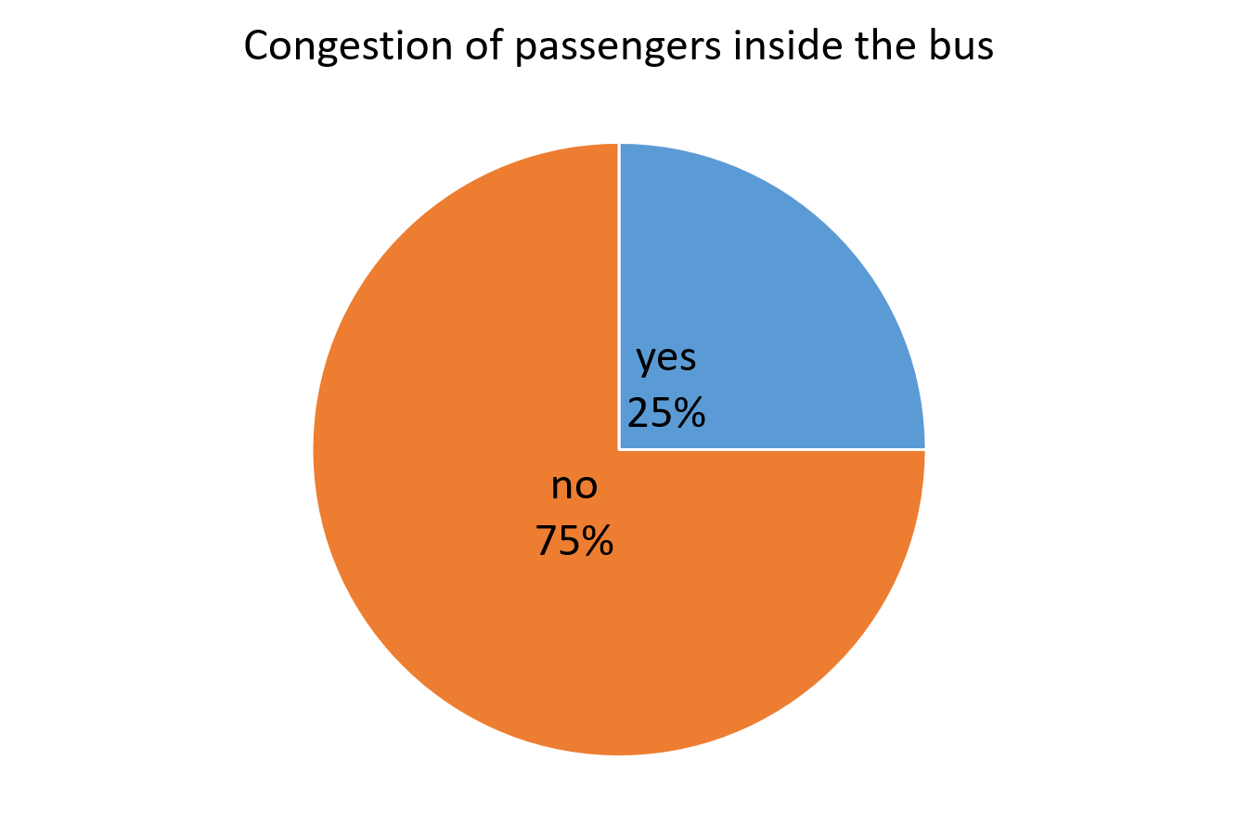
Problems
Results from survey conducted by the group
on the passengers of the BGC Bus

Slide 15
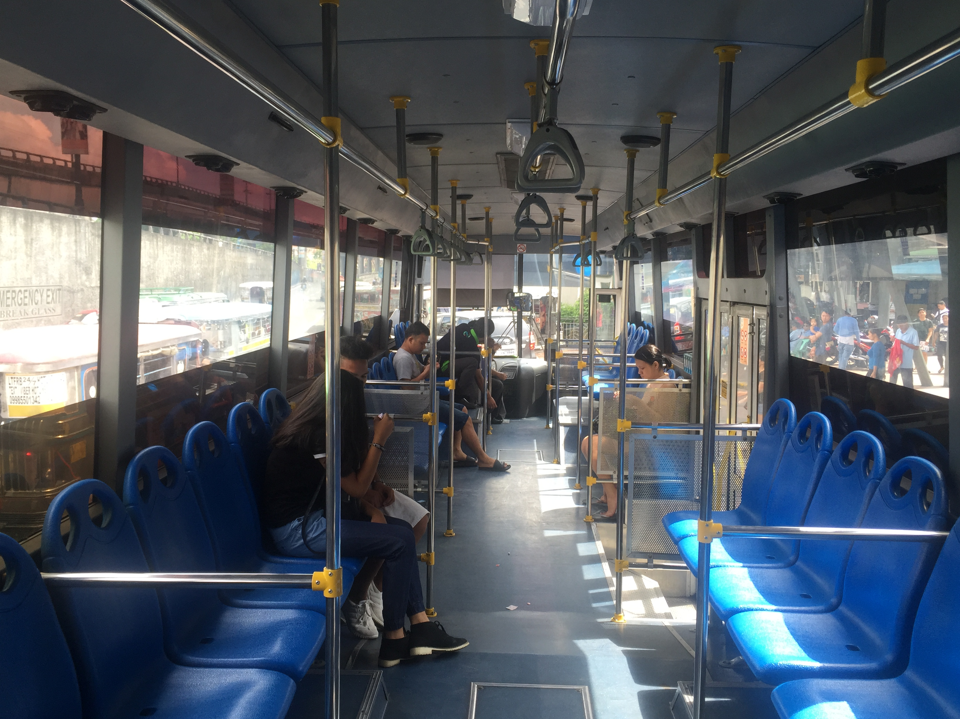
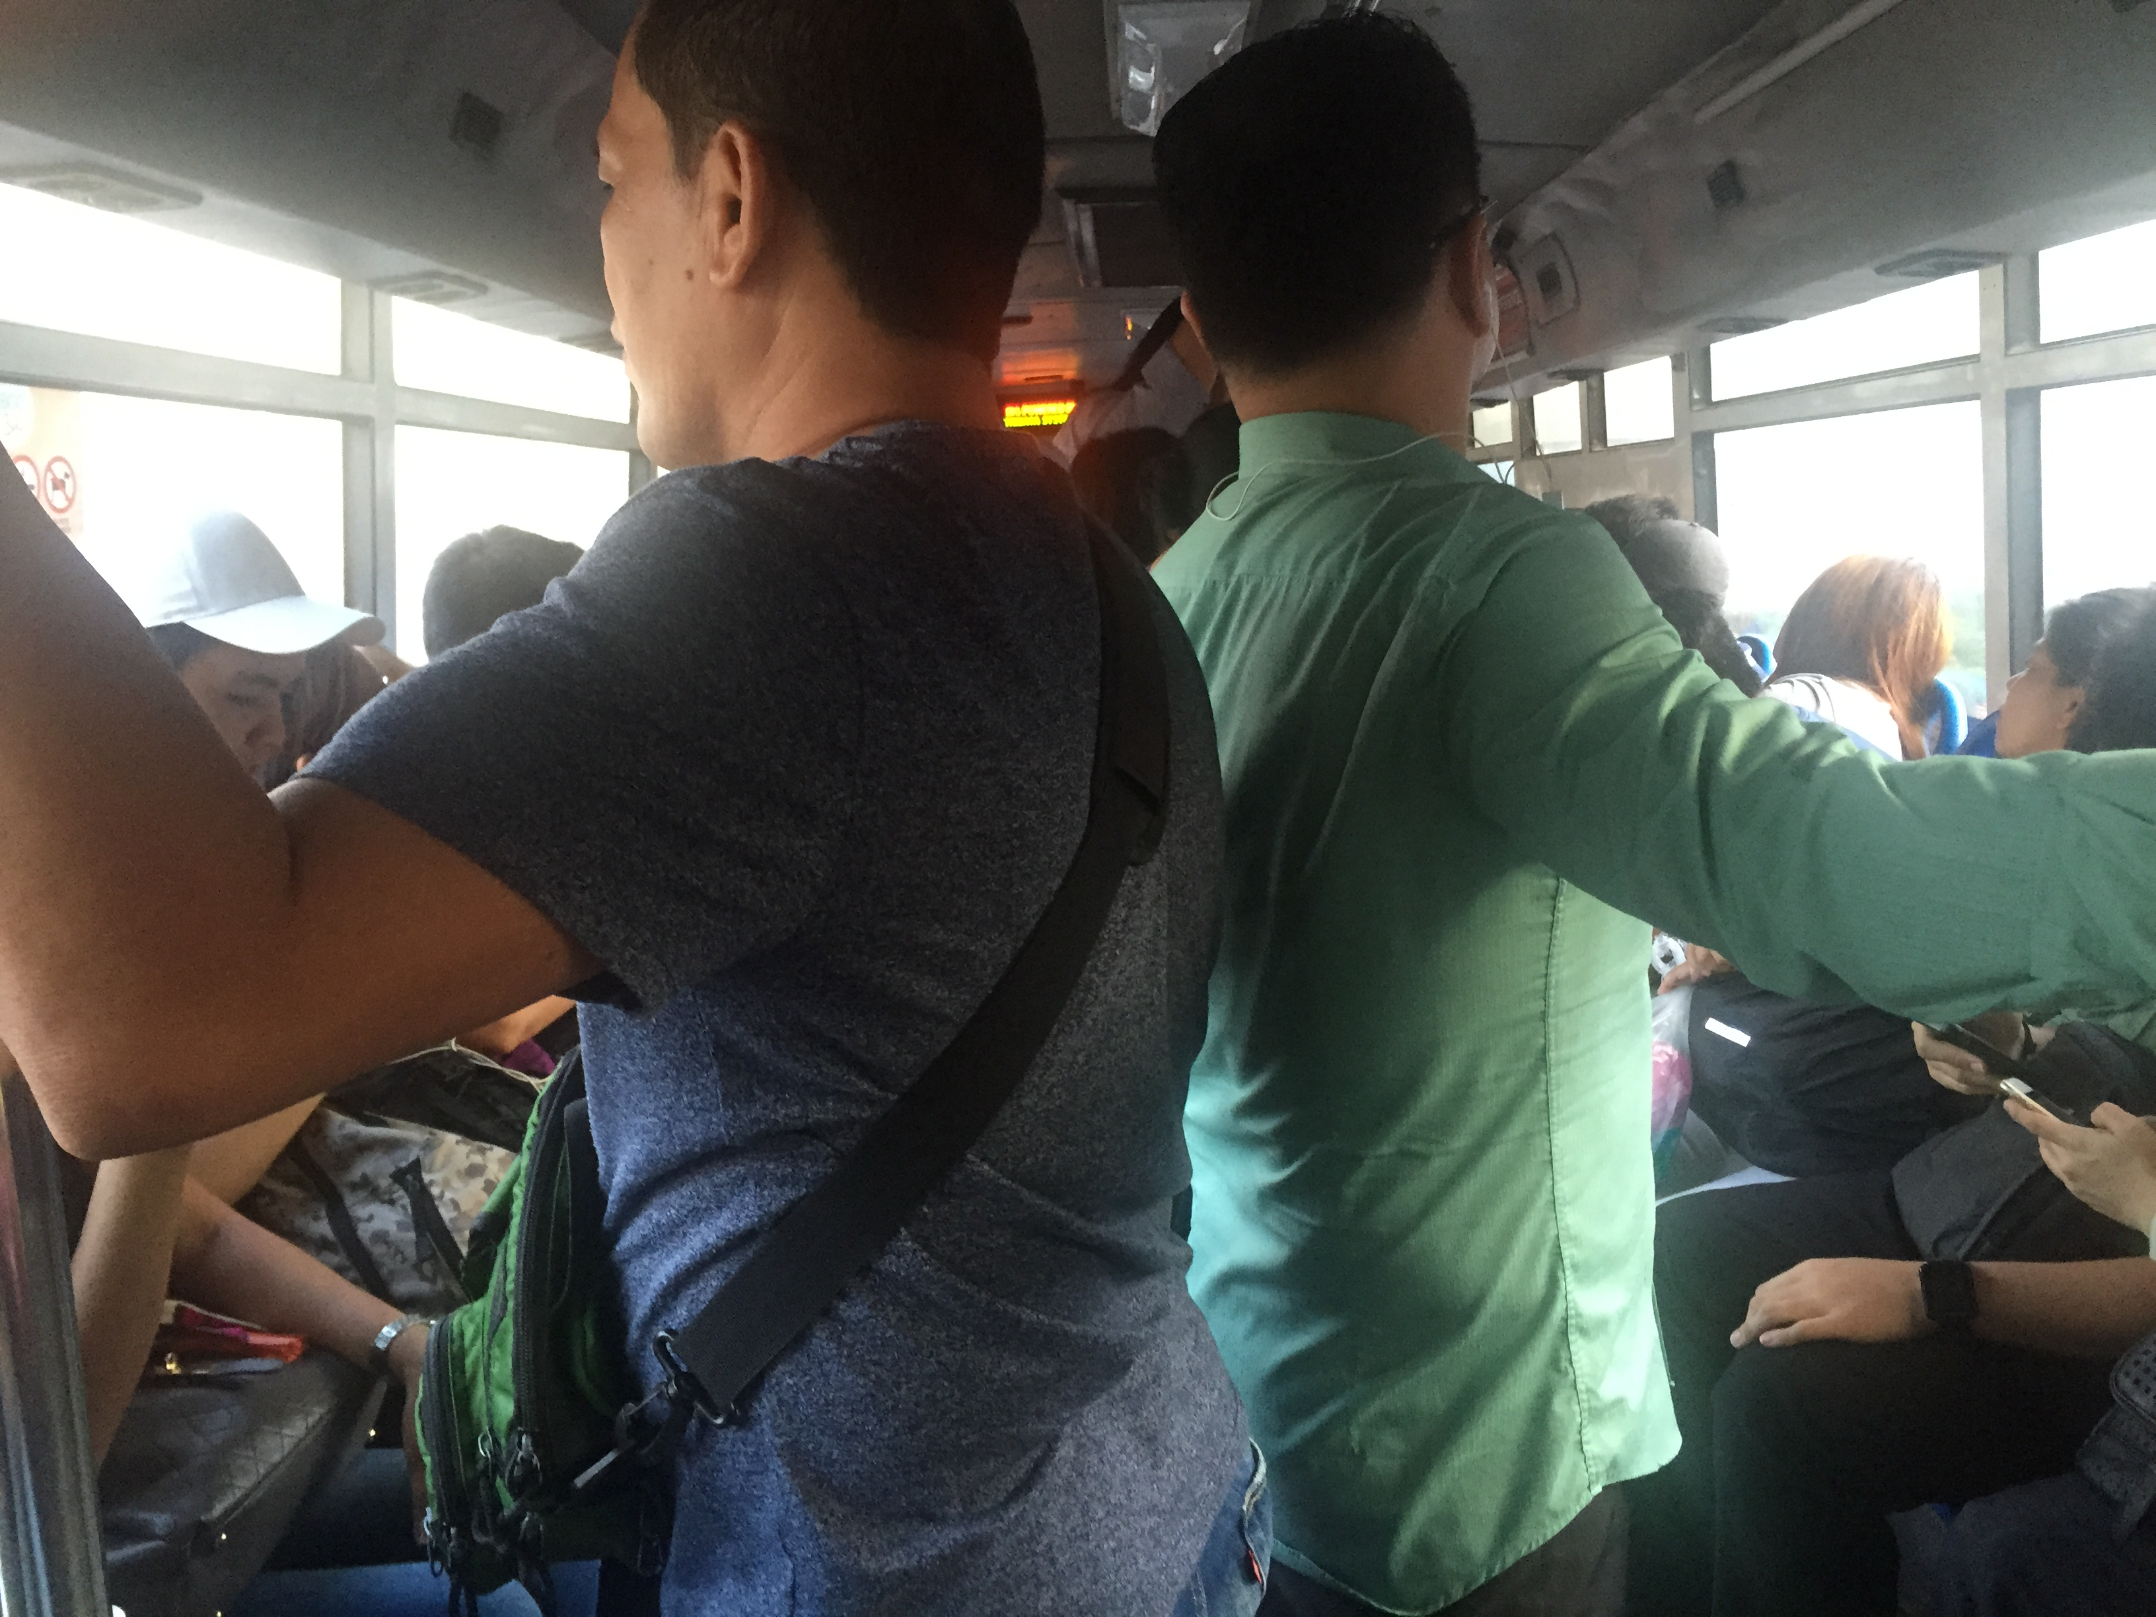
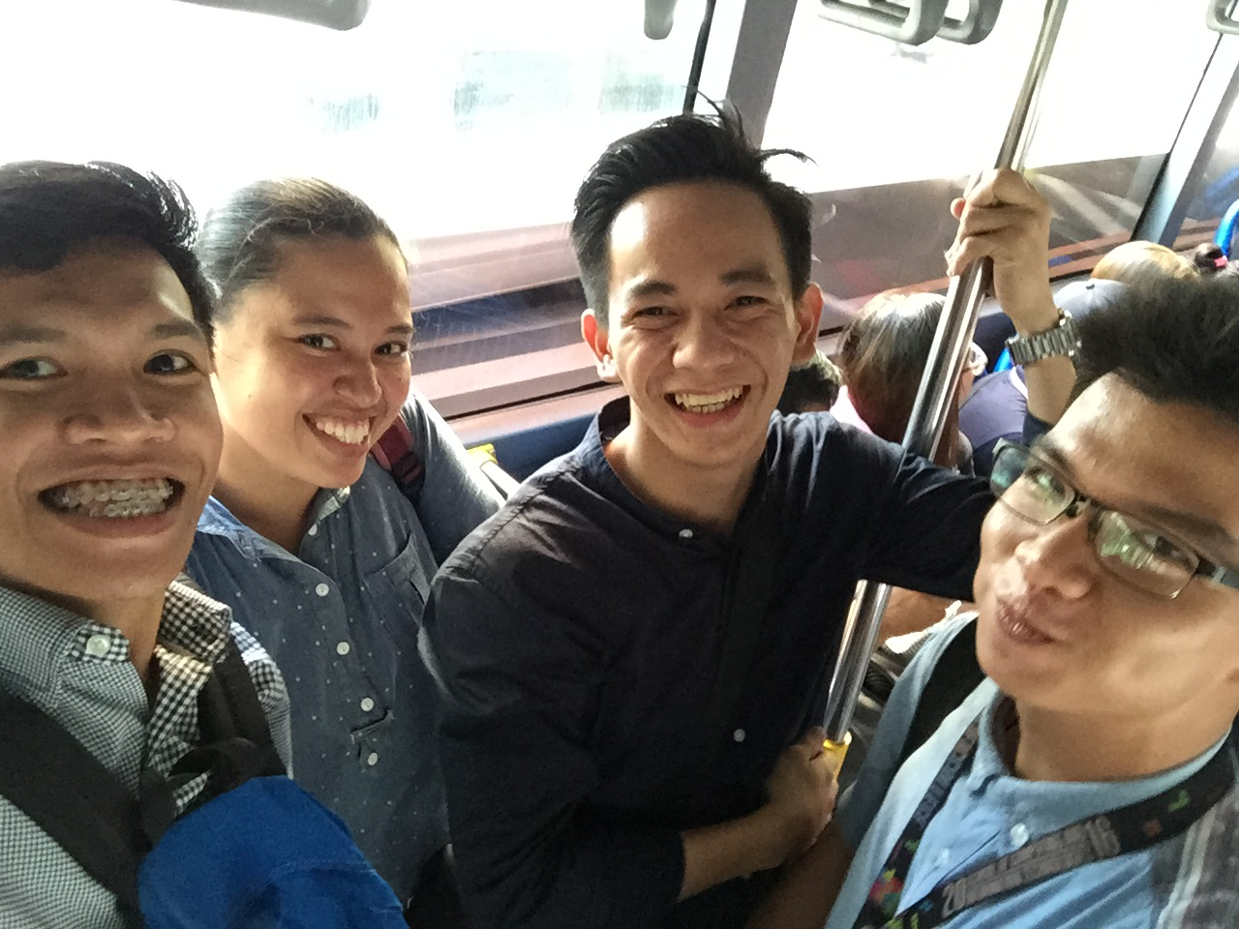
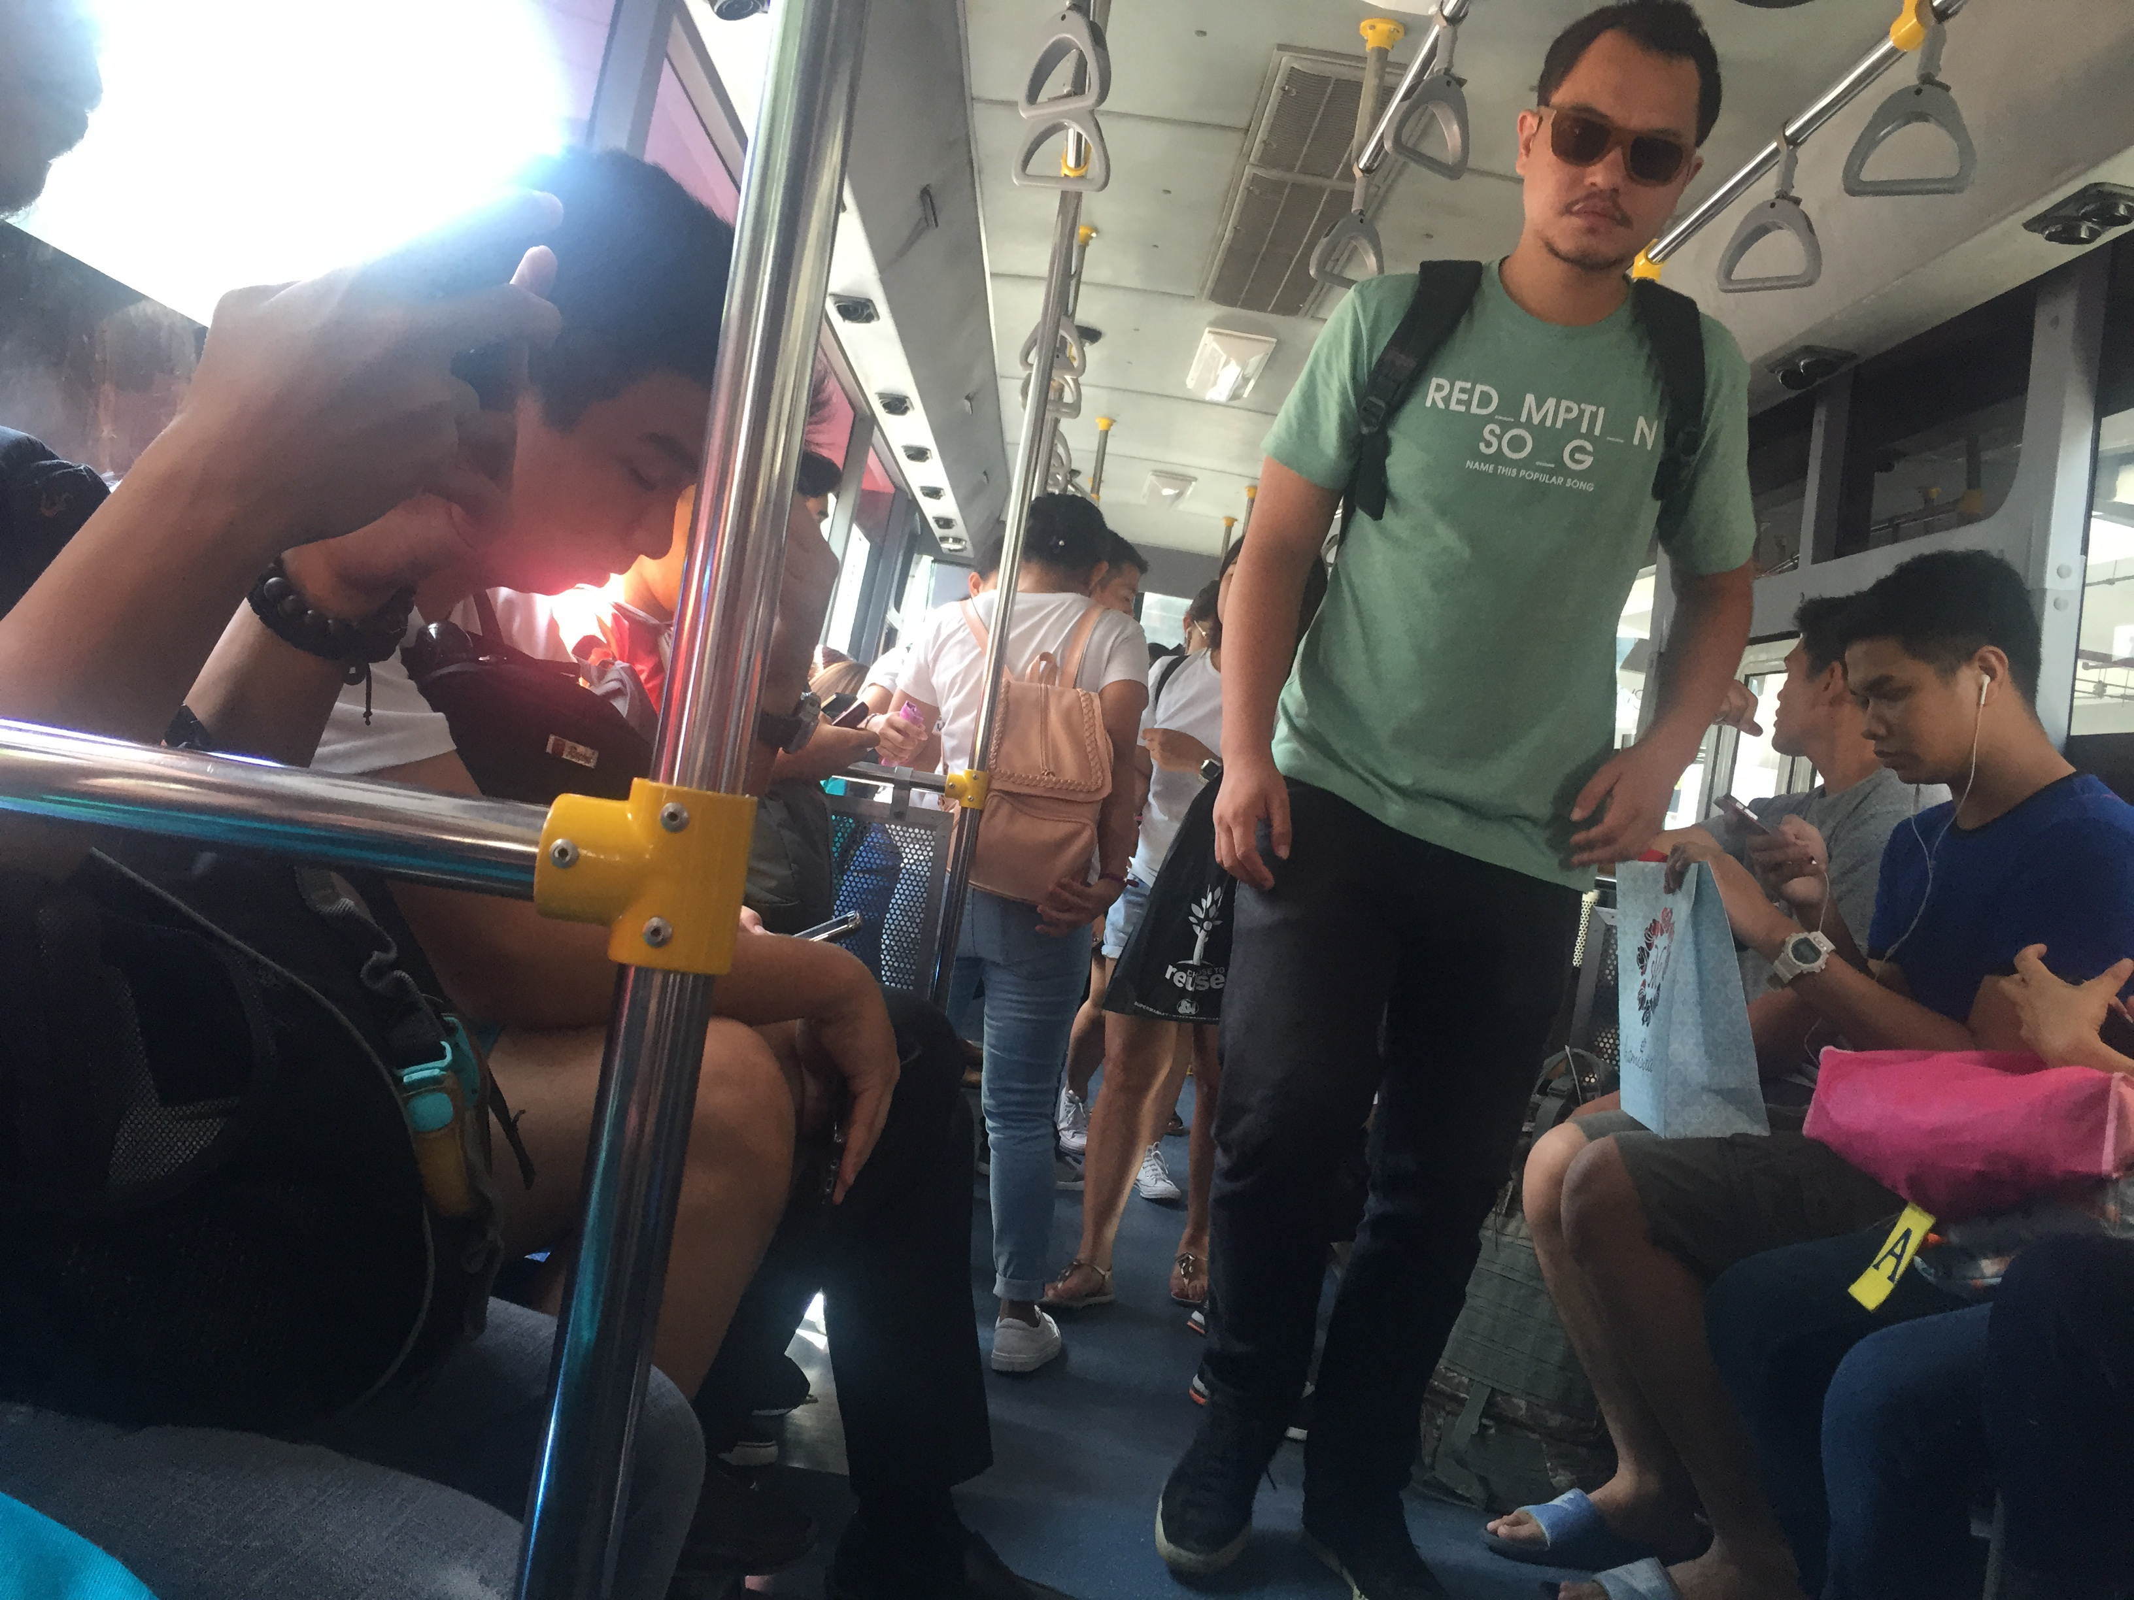

Slide 16
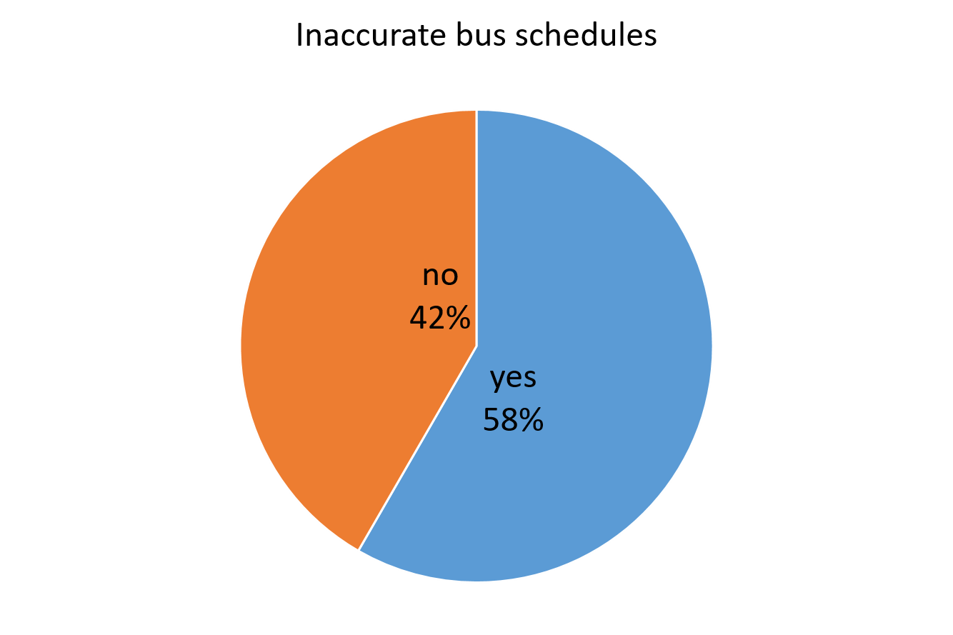
Problems
Results from survey conducted by the group
on the passengers of the BGC Bus

Slide 17
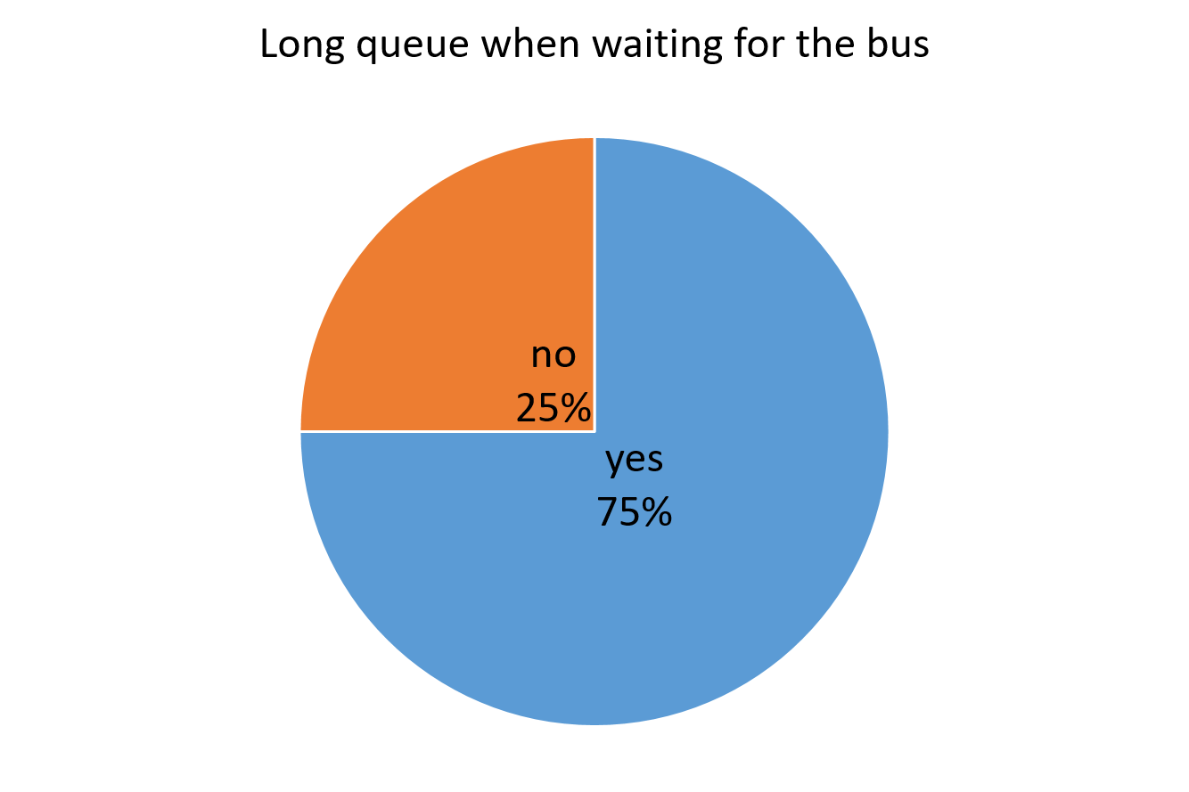
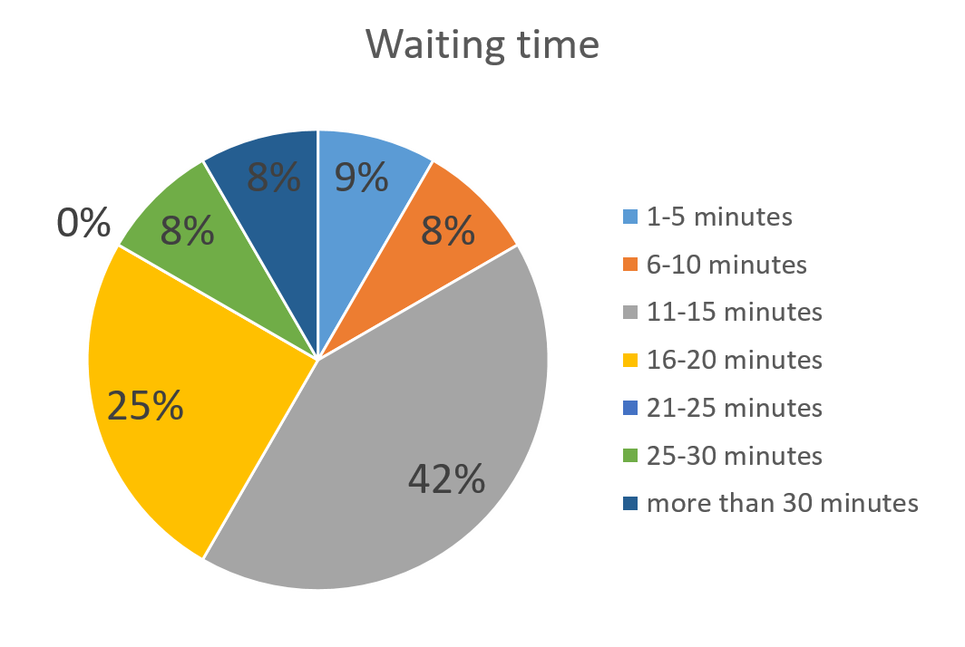
Problems
Results from survey conducted by the group
on the passengers of the BGC Bus

Slide 18
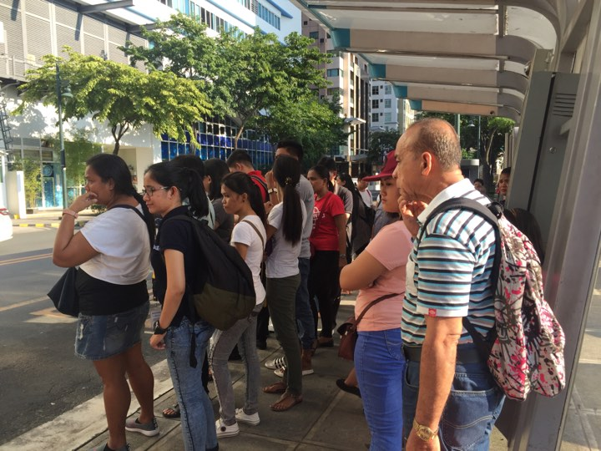
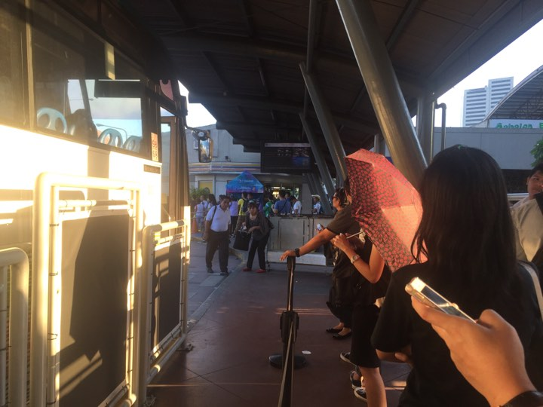
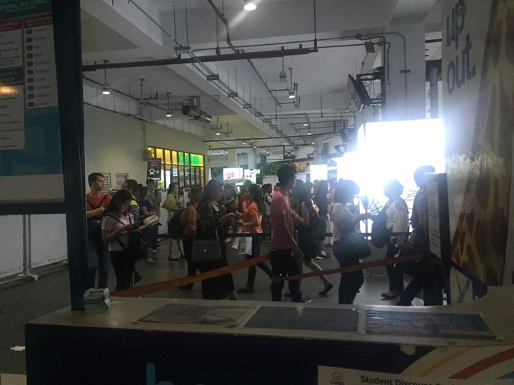
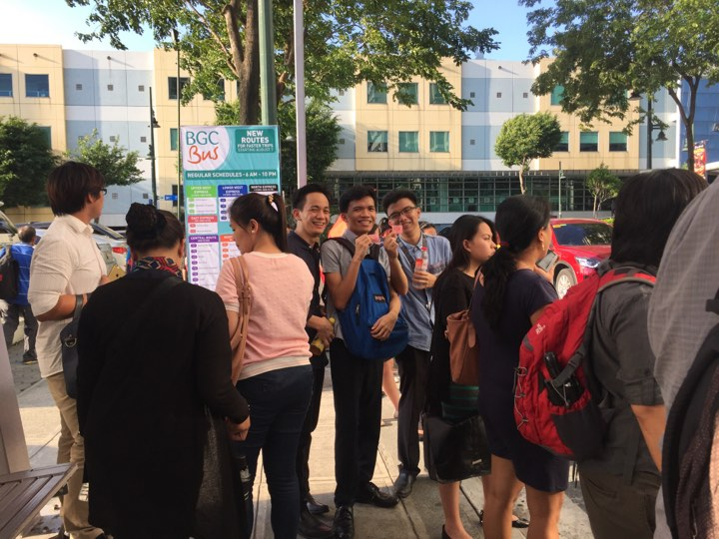

Slide 19
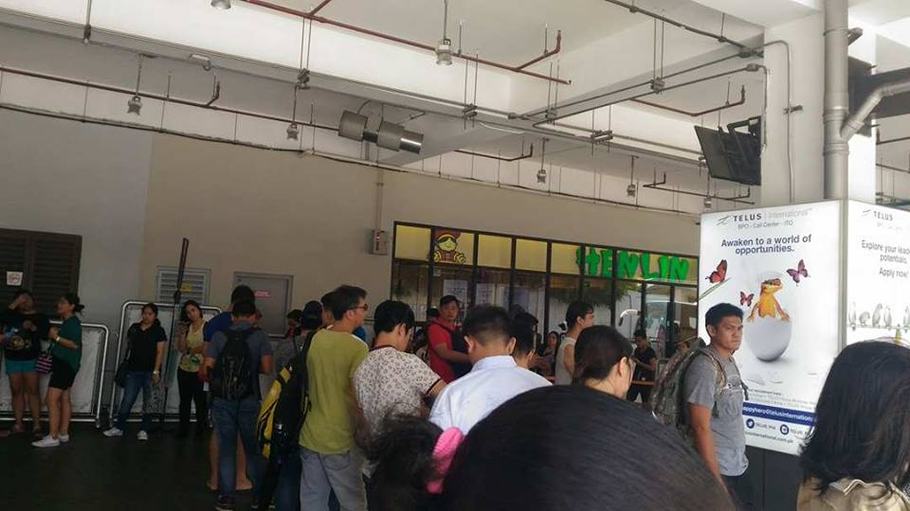
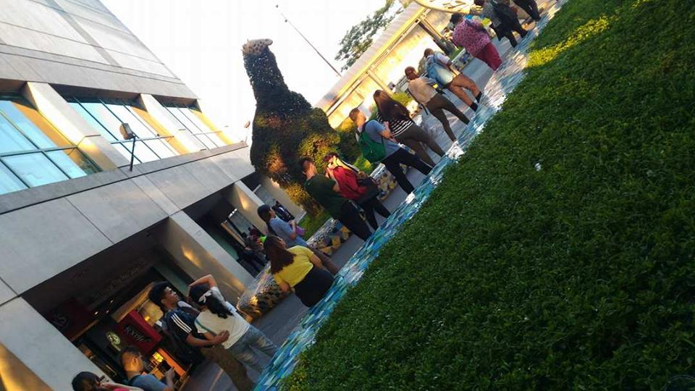
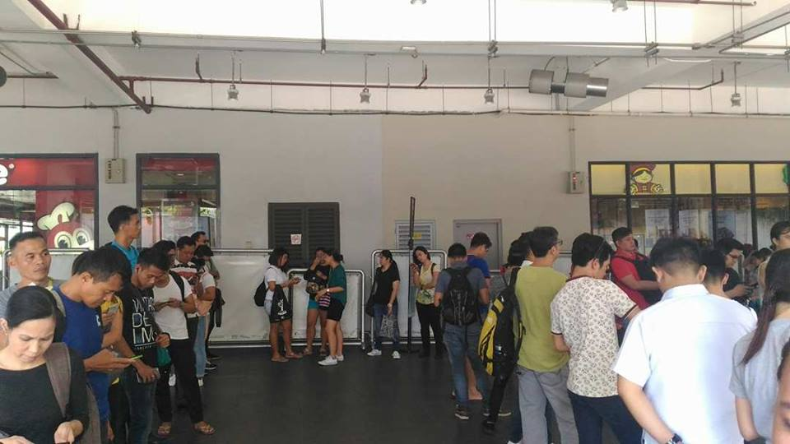

Slide 20
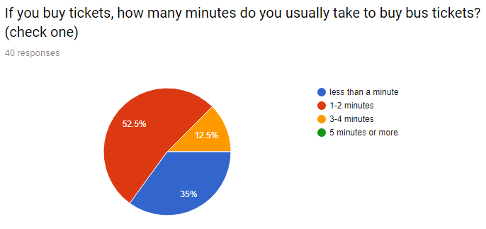
Results from survey conducted by the group
on the passengers of the BGC Bus

Slide 21
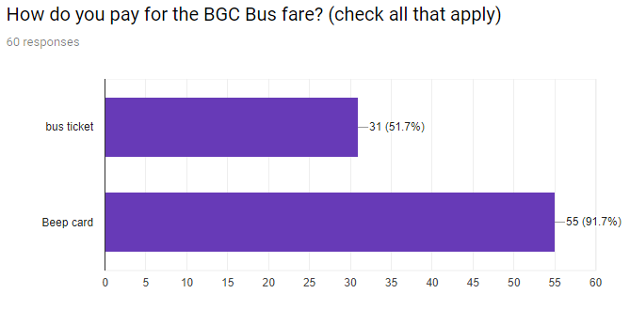
Results from survey conducted by the group
on the passengers of the BGC Bus

Slide 22
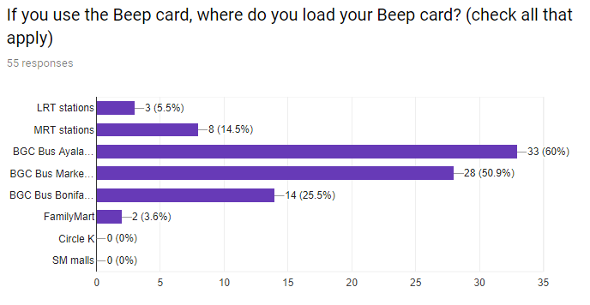
Results from survey conducted by the group
on the passengers of the BGC Bus

Slide 23
Bus Tap
Results from survey conducted by the group
on the passengers of the BGC Bus

Slide 24
Observation: Waiting Time

Slide 25
August 9, 2017, W, 6:00PM to 7:30PM
Terminal/Stop | Destination | Waiting Time
BGC Bus Ayala Terminal | Lower West Route | 4:49.12
 | Lower West Route | 16:24.33
 | Lower West Route | 5:56.43
 | Upper West Route | 7:42.31
 | Upper West Route | 21:43.14
 | East via McKinley | 17:28.34
 | East via McKinley | 25:51.13
 | East via McKinley | 6:14.37

Slide 27
August 15, 2017, F, 4:30PM to 6:00PM
Terminal/Stop | Destination | Waiting Time
Crescent Park West | BGC Bus Market! Market! Terminal | 1:54.14
 | BGC Bus Market! Market! Terminal | 19:32.30
 | BGC Bus Market! Market! Terminal | 24:43.24
 | BGC Bus Ayala Terminal | 27:06.12
 | BGC Bus Ayala Terminal | 4:18.30
 | BGC Bus Ayala Terminal | 30:44.02
 | BGC Bus Ayala Terminal | 3:54.38
 | FTI | 27:54.35

Slide 29
August 25, 2017, M, 5:30PM to 6:30PM
Terminal/Stop | Destination | Waiting Time
BGC Bus Market! Market! Terminal | East via McKinley | 01:47.57
 | East via McKinley | 21:32.40
 | East via McKinley | 14:43.44
 | Central Route | 27:06.12
 | Central Route | 30:44.02

Slide 31
September 1, 2017, F, 1:00PM to 1:30PM (Holiday)
Terminal/Stop | Destination | Waiting Time
BGC Bus Ayala Terminal | East | 02:37.57
 | East | 9:31.50
 | East | 7:56.44
 | West | 7:06.12
 | West | 5:13.45
 | West | 6:27.36
 | West | 8:44.02

Slide 33
Existing Apps

Slide 34
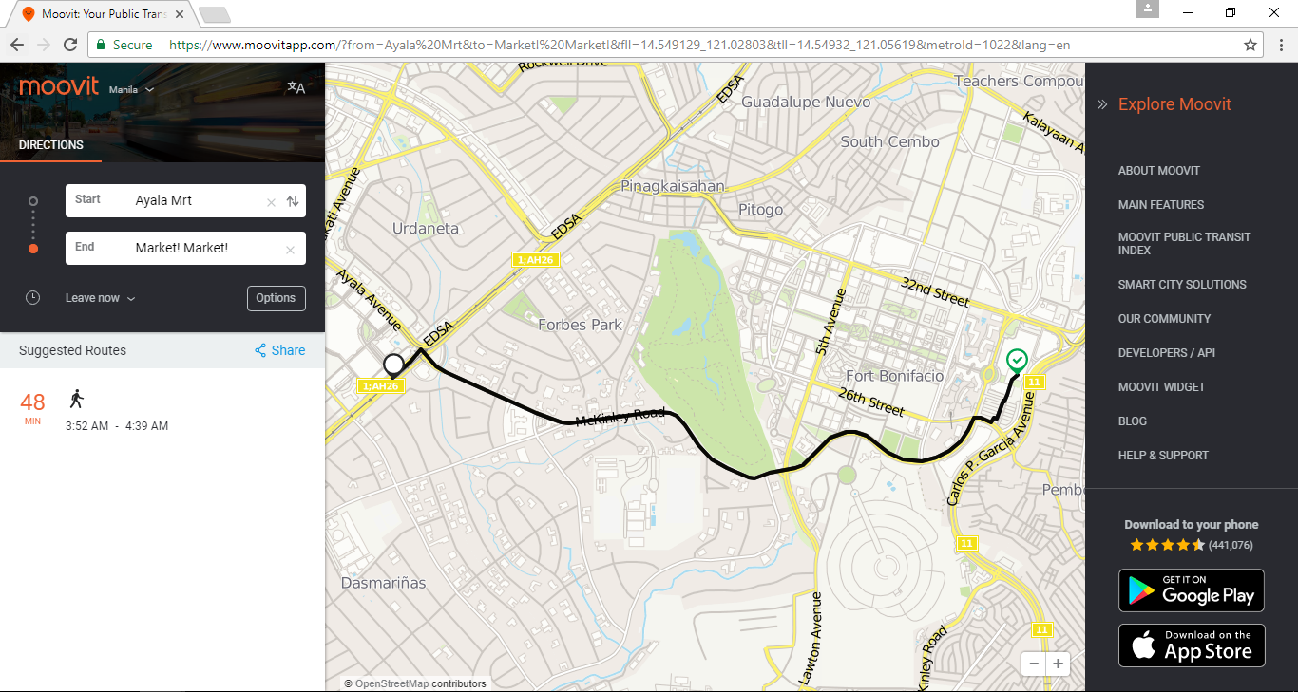
Existing Apps: Moovit

Slide 35
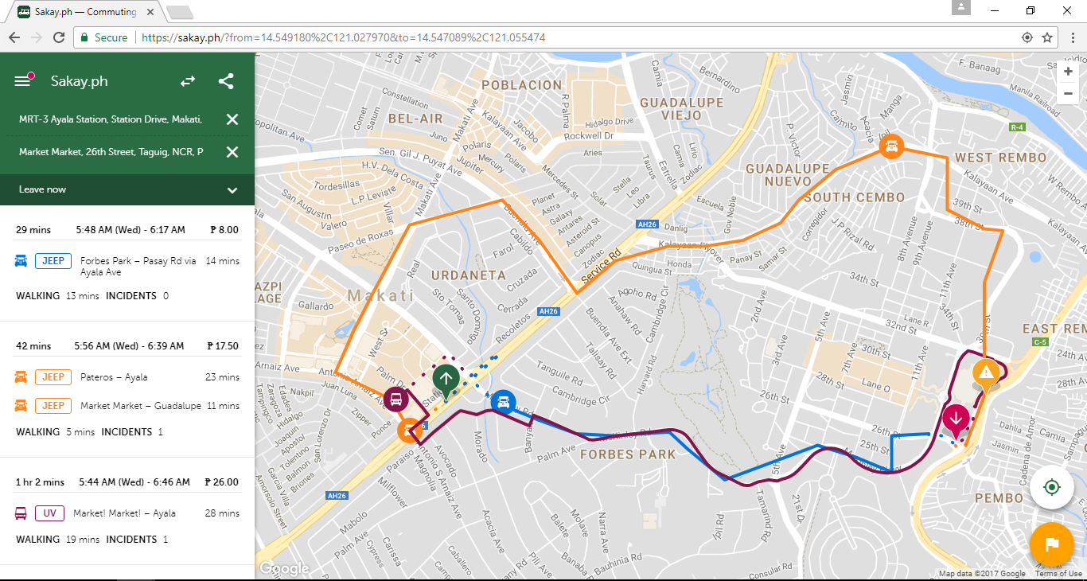
sakay.ph
Existing Apps: Sakay.ph

Slide 36
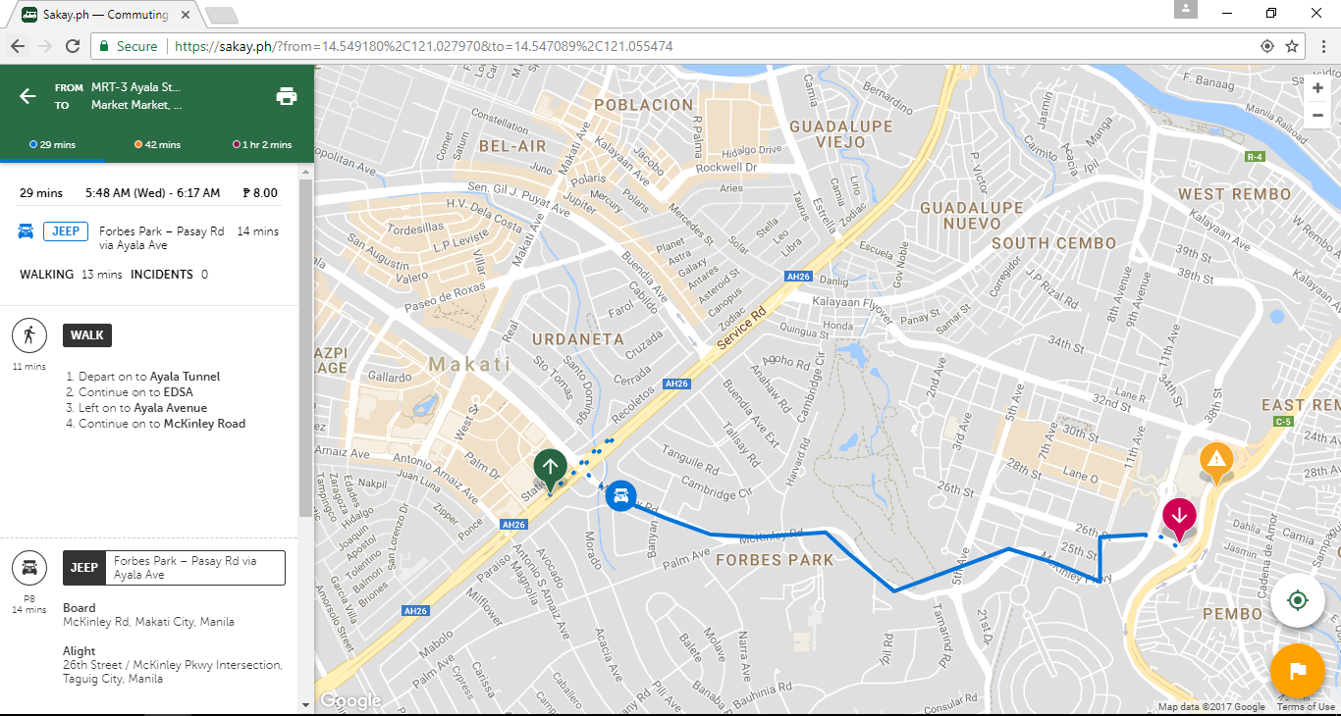
sakay.ph
Existing Apps: Sakay.ph

Slide 37
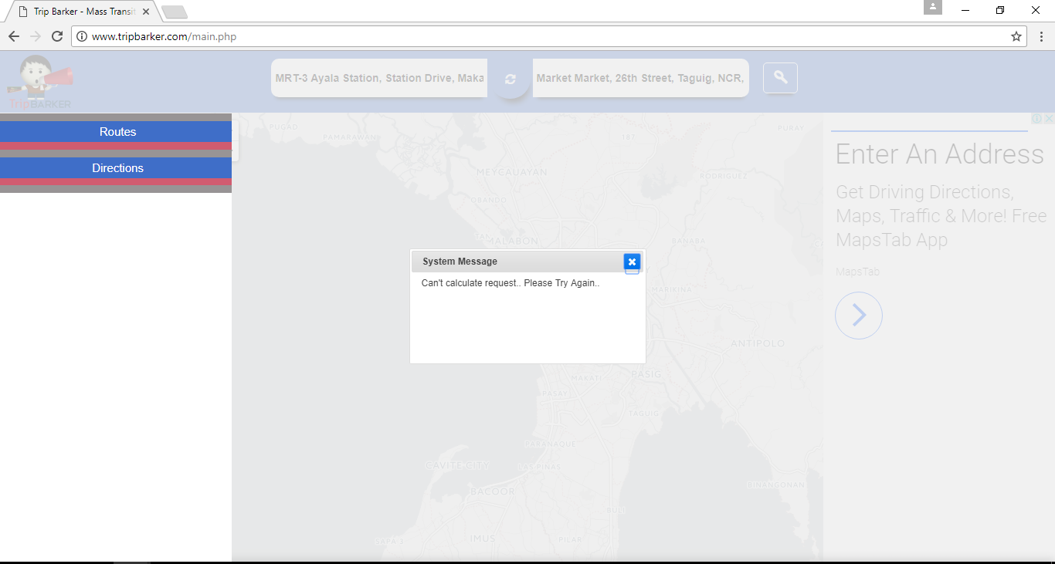
TripBarker
Existing Apps: Trip Barker

Slide 38
Existing Apps
 | Moovit | sakay.ph | TripBarker
Web URL | https://www.moovitapp.com | https://sakay.ph | http://www.tripbarker.com
Google Play Store | ✔ | ✔ | ✔
Apple App Store | ✔ | ✔ | ✖

Slide 39
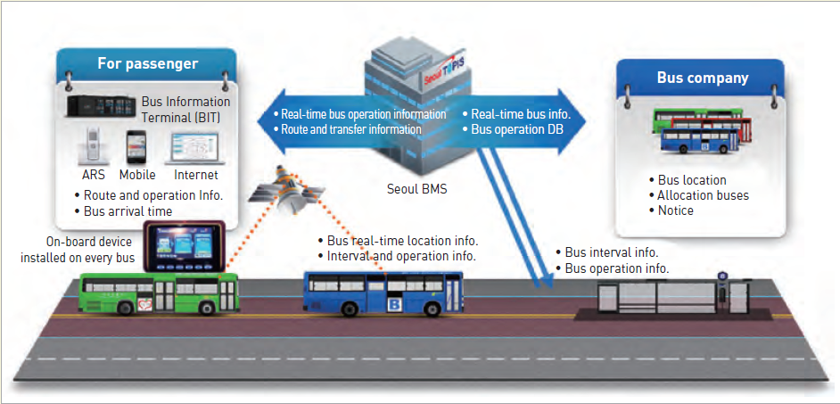
Bus Management System

Slide 40
Bus Tap

Slide 41
Objectives
The Bus Tap aims to be able to:
provide relevant information regarding the BGC Bus;
decrease the waiting time of passengers riding the BGC Bus down to 10 minutes; and
help users navigate their way around Bonifacio Global City using the BGC Bus.

Slide 42
Features
Detailed Itineraries
– 66% of the BGC Bus passengers will find this feature useful
GPS for transit
Step-by-step guidance from origin to destination
Estimated travel time
Fare
Get Off Alerts

Slide 43
Features
Operation Status
Operating Schedule
Bus Routes, Nearby Stops, Points of Interest – 66%
Arrival Times and Departure Times – 75%
Real Time Status – 50%
Bus Locator – 58%

Slide 44
Features
Congestion Status, Congestion Prediction – 42%
Locations of Beep card loading stations – 58%
Users can check the remaining balance on their Beep card – 75%

Slide 45
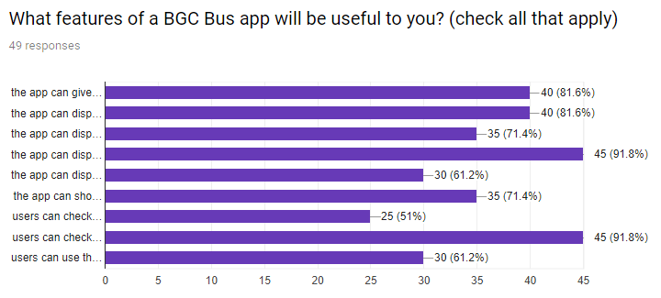
Results from survey conducted by the group
on the passengers of the BGC Bus

Slide 46
Features Comparison
Features | Moovit | sakay.ph | TripBarker | Bus Tap
Web-based | ✔ | ✔ | ✔ | ✔
Mobile-based | ✔ | ✔ | ✔ | ✔
Commuting routes | ✔ | ✔ | ✔ | ✔
Arrival and departure times | ✖ | ✖ | ✖ | ✔
Minutes-to-arrival | ✖ | ✖ | ✖ | ✔
Bus locator | ✖ | ✖ | ✖ | ✔
Check Beep card balance | ✖ | ✖ | ✖ | ✔

Slide 47
Scope and Limitations
both web and mobile
for Android devices only
for BGC Bus only
limited to within BGC and select areas of Taguig City (Arca South Express), Makati City (Ayala Express), and Sta. Rosa, Laguna (Nuvali Express)

Slide 48
UML Diagrams

Slide 49
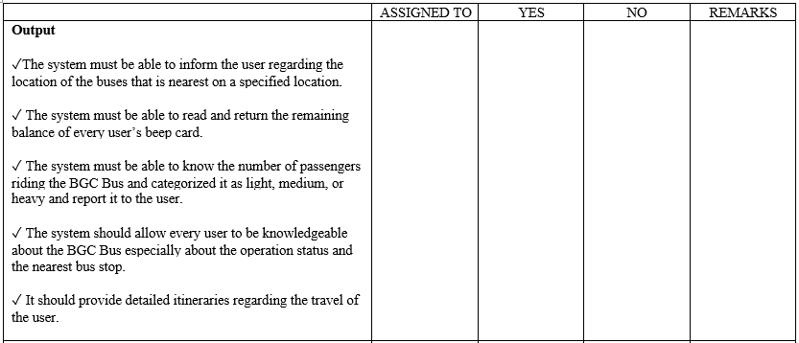
Software Requirements Specification (SRS)

Slide 50
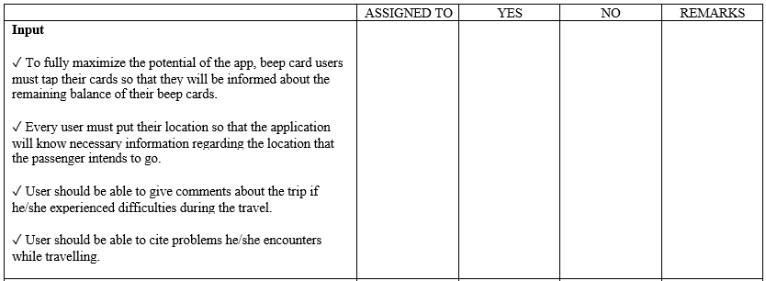
Software Requirements Specification (SRS)

Slide 51
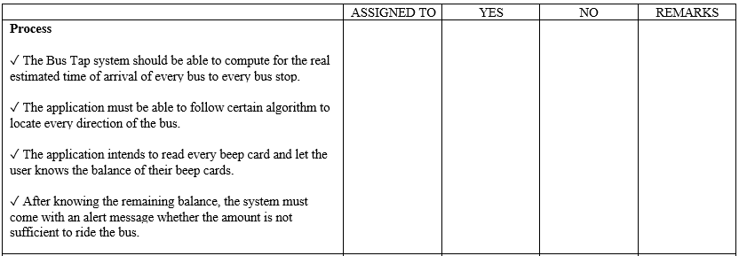
Software Requirements Specification (SRS)

Slide 52
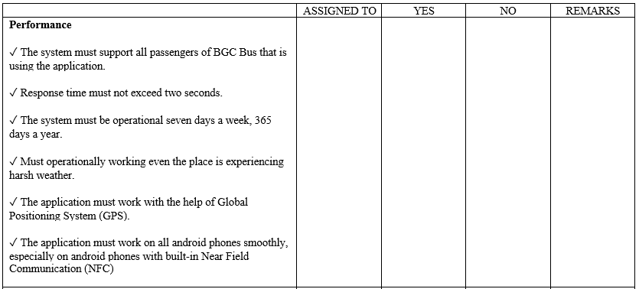
Software Requirements Specification (SRS)

Slide 53
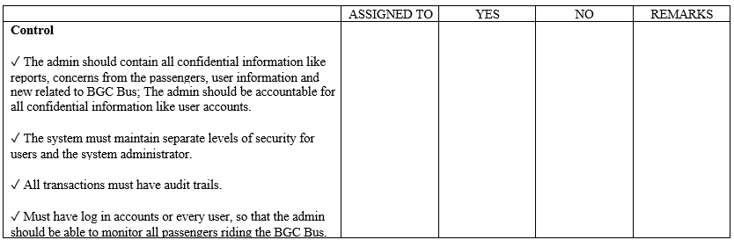
Software Requirements Specification (SRS)

Slide 54
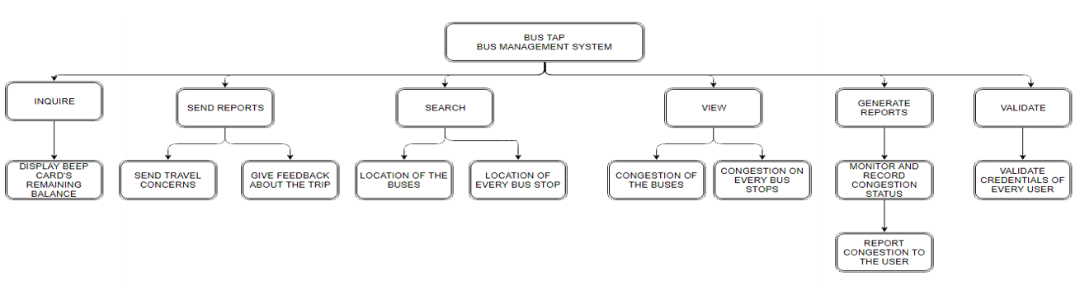
Functional Description Diagram (FDD)

Slide 55
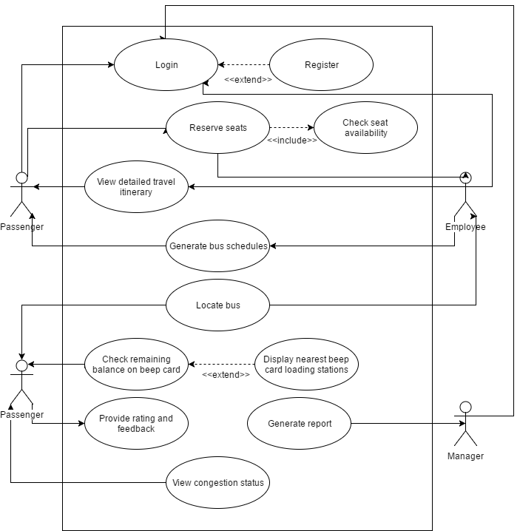
Use Case Diagram

Slide 56
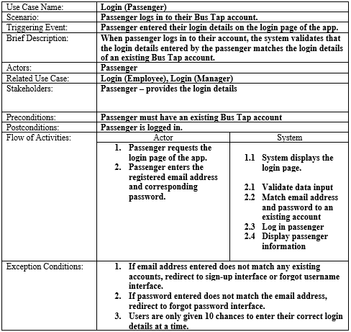
Full Use Case Description

Slide 57
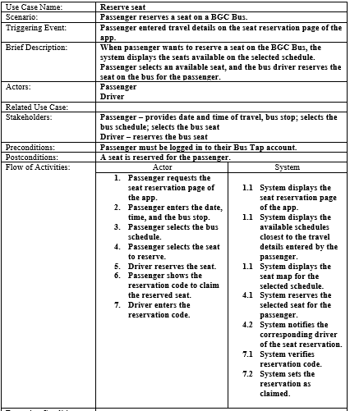
Full Use Case Description

Slide 58
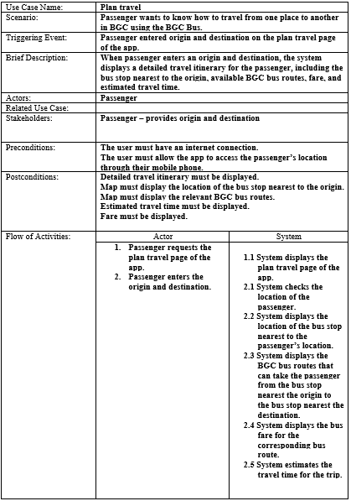
Full Use Case Description

Slide 59
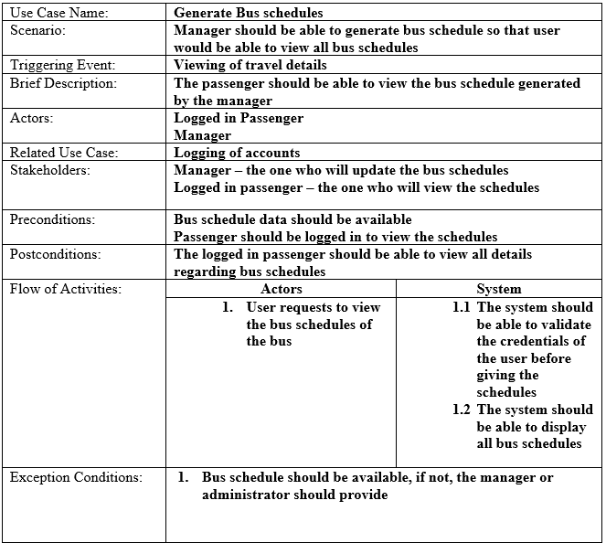
Full Use Case Description

Slide 60
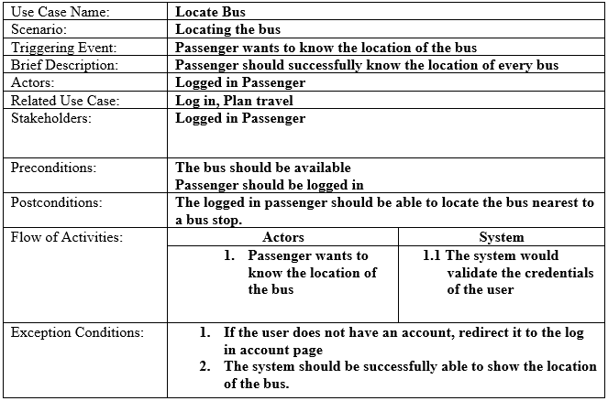
Full Use Case Description

Slide 61
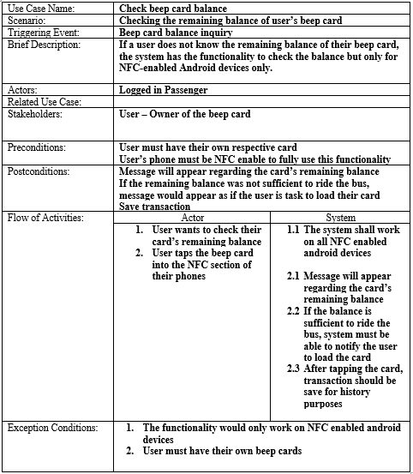
Full Use Case Description

Slide 62
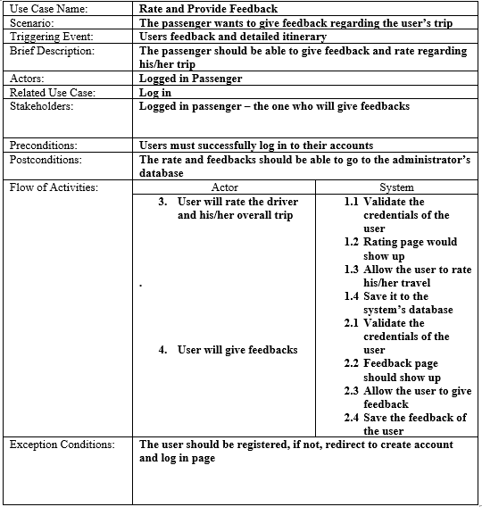
Full Use Case Description

Slide 63

Full Use Case Description

Slide 64

Event Table

Slide 65

Data Flow Diagram
Context Diagram

Slide 66

DFD Level 1

Slide 67

Entity Relationship Diagram (ERD)

Slide 68
Data Dictionary
ENTITY: BEEP_CARD
Attribute Name | Data Type
beep_number | VARCHAR(16)
beep_lasttransaction | DATETIME
beep_balance | DECIMAL(7,2)
pass_mobilenumber | VARCHAR(11)

Slide 69
Data Dictionary
ENTITY: PASSENGER
Attribute Name | Data Type
pass_mobilenumber | VARCHAR(11)
pass_password | VARCHAR(50)
pass_fname | VARCHAR(50)
pass_lname | VARCHAR(50)
pass_birthdate | DATE
pass_gender | CHAR
pass_occupation | VARCHAR(50)

Slide 70
Data Dictionary
ENTITY: RESERVATION
Attribute Name | Data Type
res_code | VARCHAR(10)
pass_mobilenumber | VARCHAR(11)
sched_code | VARCHAR(10)
res_seatnumber | INT
res_status | VARCHAR(45)
emp_id | VARCHAR(50)

Slide 71
Data Dictionary
ENTITY: FEEDBACK
Attribute Name | Data Type
pass_mobilenumber | VARCHAR(11)
sched_code | VARCHAR(10)
feed_rating | INT
feed_feedback | VARCHAR(100)

Slide 72
Data Dictionary
ENTITY: BUS
Attribute Name | Data Type
bus_platenumber | VARCHAR(6)
bus_availability | VARCHAR(50)
bus_location | VARCHAR(50)
bus_congestionlevel | INT
bus_beeptapnumber | VARCHAR(16)
route_code | INT(3)

Slide 73
Data Dictionary
ENTITY: BUS_SCHEDULE
Attribute Name | Data Type
sched_code | VARCHAR(10)
sched_date | DATE
bus_platenumber | VARCHAR(6)
sched_origin | VARCHAR(4)
sched_destination | VARCHAR(4)
sched_arrival | TIME
sched_departure | TIME
emp_id | VARCHAR(50)

Slide 74
Data Dictionary
ENTITY: EMPLOYEE
Attribute Name | Data Type
emp_id | VARCHAR(50)
emp_password | VARCHAR(50)
emp_fname | VARCHAR(50)
emp_lname | VARCHAR(50)
emp_lastlogin | DATETIME
emp_classification | VARCHAR(10)

Slide 75
Data Dictionary
ENTITY: BUS_ROUTE
Attribute Name | Data Type
route_code | INT(3)
route_name | VARCHAR(50)
route_availability | VARCHAR(50)
route_operatingschedule | VARCHAR(50)
route_fare | DECIMAL(4,2)

Slide 76
Data Dictionary
ENTITY: BUS_STOP
Attribute Name | Data Type
stop_code | VARCHAR(4)
stop_name | VARCHAR(50)
stop_location | VARCHAR(50)
stop_ticketavailability | CHAR
stop_congestionlevel | INT
route_code | INT(3)

Slide 77
Data Dictionary
ENTITY: CONGESTION
Attribute Name | Data Type
stop_code | VARCHAR(4)
cong_datetime | DATETIME
cong_level | VARCHAR(10)

Slide 78

Object Diagram

Slide 79

Class Diagram

Slide 80

Activity Diagram: Login

Slide 81

Activity Diagram: Reserve seat

Slide 82

Activity Diagram: Plan travel

Slide 83

Activity Diagram: Generate bus schedules

Slide 84

Activity Diagram: Locate bus

Slide 85

Activity Diagram: Check beep card balance

Slide 86

Activity Diagram: Rate and provide feedback

Slide 87

Activity Diagram: View congestion

Slide 88

Activity Diagram: Generate report

Slide 89
Thank you

